Slide 1
Model Train
Session 7

Slide 2
OUR SCHEDULE
Session 1 : Revision and Simple Command on Linux
Quick Flashback on Phase 1
Session 3: Revise back about OpenCV
Task Given, Creating package, workspace
Revise back some useful command in Linux
Detecting Edges and Applying Image Filters
Session 2: Revise back about Python
Revise back basic of python
Some exercises to test programming skills
Blurring
Edge detection
Converting between different color spaces
# DAY 1

Slide 3
OUR SCHEDULE
Session 4: Continue OpenCV
Motion blur
Session 6: : Labelling and Training model
Do the labelling
Session 5: Installation of YOLO
Introduction to YOLO Bbox Annotation Tool
Object Tracking
Installation the Tool on LinuxOS (Laptop)
Sharpening
Embossing
Train the model by using Laptop
# DAY 2

Slide 4
OUR SCHEDULE
Session 7: Image Training
Session 8: ROS + OPENCV + YOLO
Setup Turtlebot
Creating train.txt and test.txt
Deploying OpenCV and Yolo on Turtlebot for Follow-Person and Line-Following
Train your images
# DAY 3

Slide 5
cv2.filter2D()

Slide 6
Robotics Teaching Kit Modules
Module 1 Course Introduction | Course Introduction and Overview Introduction to Robotics Introduction to Jetson TK1/TX1 Jet Overview Introduction to ROS
Module 2 Sensors | Sonar, Accelerometer, Gyroscope Camera, Motors, Encoders
Module 3 Computer Vision | ​Introduction to Computer Vision Image Filtering Image Moments
Module 4 Machine Learning | ​Introduction to Machine Learning ​Neural Networks Caffe

Slide 7
Robotics Teaching Kit Modules
Module 5 Dead Reckoning | Introduction to Dead Reckoning Calculating Positions Sensor Fusion and Kalman Filters
Module 6 Path Planning | Introduction to Path Planning A* Planning
Module 7 Control | Introduction to Control Systems PID Control
Module 8 Robot Localization | Introduction to Robot Localization Localization with Particle Filters
Module 9 Mapping | Introduction to Mapping SLAM
Module 10 Final Project | ​Motivation ​Harvester Robot Capture the Flag Game Color Follower

Slide 8
Behind the scene of 2D convolutions
This method applied for any filter
cv2.filter2D()
cv2.filter2D(res,-1,kernel)

Slide 9
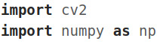
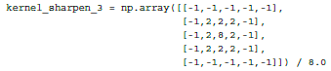
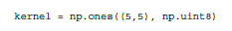
Introduction to numpy

Slide 10
Sharpening
Image sharpening process looks like:
To sharpen the edges in the image.
To enhance the edges in an image that's not crisp.

Slide 11
As you can see in the preceding figure, the level of sharpening depends on the type of kernel we use.
We have a lot of freedom to customize the kernel here, and each kernel will give you a different kind of sharpening.
To just sharpen an image, like we are doing in the top right image in the preceding picture, we would use a kernel like this:

Slide 12
If we want to do excessive sharpening, like in the bottom left image, we would use the following kernel:
But the problem with these two kernels is that the output image looks artificially enhanced. If we want our images to look more natural, we would use an Edge Enhancement filter.
The underlying concept remains the same, but we use an approximate Gaussian kernel to build this filter.
It will help us smoothen the image when we enhance the edges, thus making the image look more natural.

Slide 13
Gaussian kernel

Slide 14
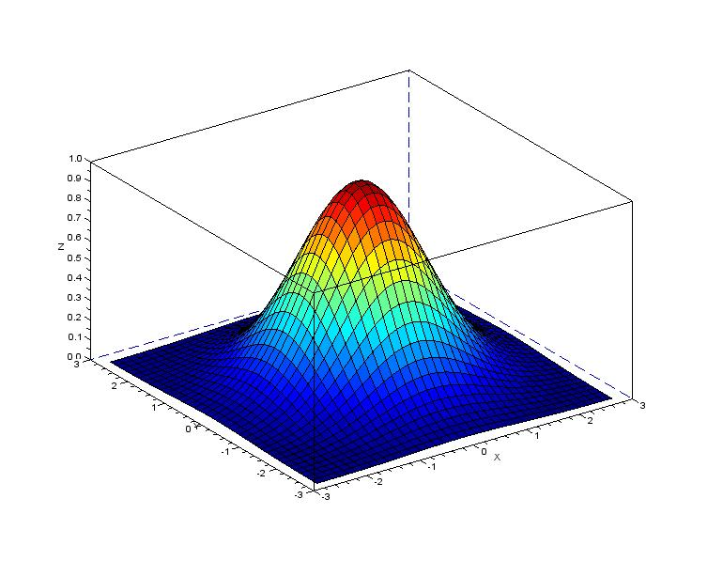
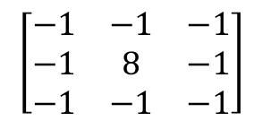
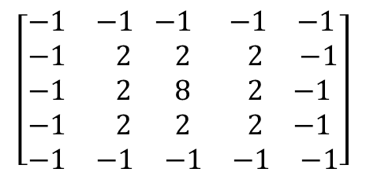
Gaussian kernel
$$\left[\begin{matrix}\begin{matrix}−1 \\ −1 \\ −1\end{matrix} & \begin{matrix}−1 \\ 8 \\ −1\end{matrix} & \begin{matrix}−1 \\ −1 \\ −1\end{matrix}\end{matrix}\right]$$
$$\left[\begin{aligned}&\begin{matrix}−1 & −1\end{matrix}\begin{matrix} −1 & −1 & −1\end{matrix} \\ &\begin{matrix}\begin{matrix}−1 & 2\end{matrix} & \begin{matrix} 2 & 2 & −1\end{matrix}\end{matrix} \\ &\begin{matrix}\begin{matrix}−1 & 2\end{matrix} & \begin{matrix} 8 & 2 & −1\end{matrix}\end{matrix} \\ &\begin{matrix}\begin{matrix}−1 & 2\end{matrix} & \begin{matrix}2 & 2 & −1\end{matrix}\end{matrix} \\ &\begin{matrix}\begin{matrix}−1 & −1\end{matrix} & \begin{matrix}−1 & −1 & −1\end{matrix}\end{matrix}\end{aligned}\right]$$

Slide 15
Embossing
Convert it into an embossed image.
It take each pixel and replace it with a shadow or a highlight.
Let's say we are dealing with a relatively plain region in the image.
Need to replace it with plain gray color because there's not much information there.
If there is a lot of contrast in a particular region, we will replace it with a white pixel (highlight), or a dark pixel (shadow), depending on the direction in which we are embossing.
This is what it will look like:

Slide 16
Erosion and dilation
Erosion and dilation are morphological image processing operations
Let's see what these operations look like:
Original
Erosion
Dilation

Slide 17
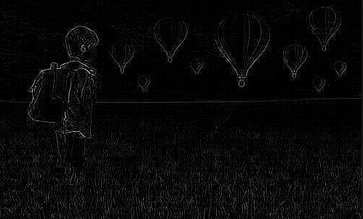
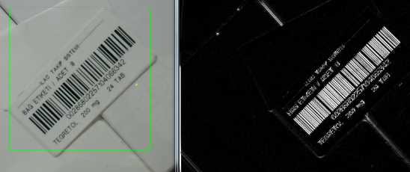
Erosion and dilation
Sobel
Laplacian

Slide 18
Enhancing the contrast in an image
Whenever we capture images in low-light conditions, the images turn out to be dark.
This typically happens when you capture images in the evening or in a dimly lit room.
When this happens, a lot of details in the image are not clearly visible to the human eye.
We use a process called Histogram Equalization to achieve this.
To give an example, this is what it looks like before and after contrast enhancement:
As we can see here, the input image on the left is really dark. To rectify this, we need to adjust the pixel values so that they are spread across the entire spectrum of values, that is, between 0 and 255.

Slide 19
Challenge: Lighting Conditions
Graphics is hard, vision is harder slide
Notes:
The same scene, even from the same point of view, may look dramatically different under different lighting conditions.
19

Slide 20
Exercise
Use your webcam :
Perform enhancement of the image contrast

Slide 21
Drawing on an image
rectangle
cv2.rectangle(output, (320, 60), (420, 160), (0, 0, 255), 2)
Syntax: cv2.rectangle(image, start_point, end_point, color, thickness)
circle
cv2.circle(output, (300, 150), 20, (255, 0, 0), -1)
Syntax: cv2.circle(image, center_coordinates, radius, color, thickness)
line
cv2.line(output, (60, 20), (400, 200), (0, 0, 255), 5)
Syntax: cv2.line(image, start_point, end_point, color, thickness)
Notes:
21

Slide 22
Text in your image: PutText
cv2.putText(output, "OpenCV + Jurassic Park!!!", (10, 25), cv2.FONT_HERSHEY_SIMPLEX, 0.7, (0, 255, 0), 2)
Syntax: cv2.putText(image, text, org, font, fontScale, color[, thickness[, lineType[, bottomLeftOrigin]]])
Notes:
22

Slide 23
Detecting Shapes and Segmenting an Image
In this chapter, we are going to learn about shape analysis

Slide 24
Contour analysis and shape matching
Contour analysis is a very useful tool in the field of computer vision. We deal with a lot of shapes in the real world and contour analysis helps in analyzing those shapes using various algorithms.
Let's say we want to identify the boomerang shape in the following image:
In order to do that, we first need to know what a regular boomerang looks like:

Slide 25
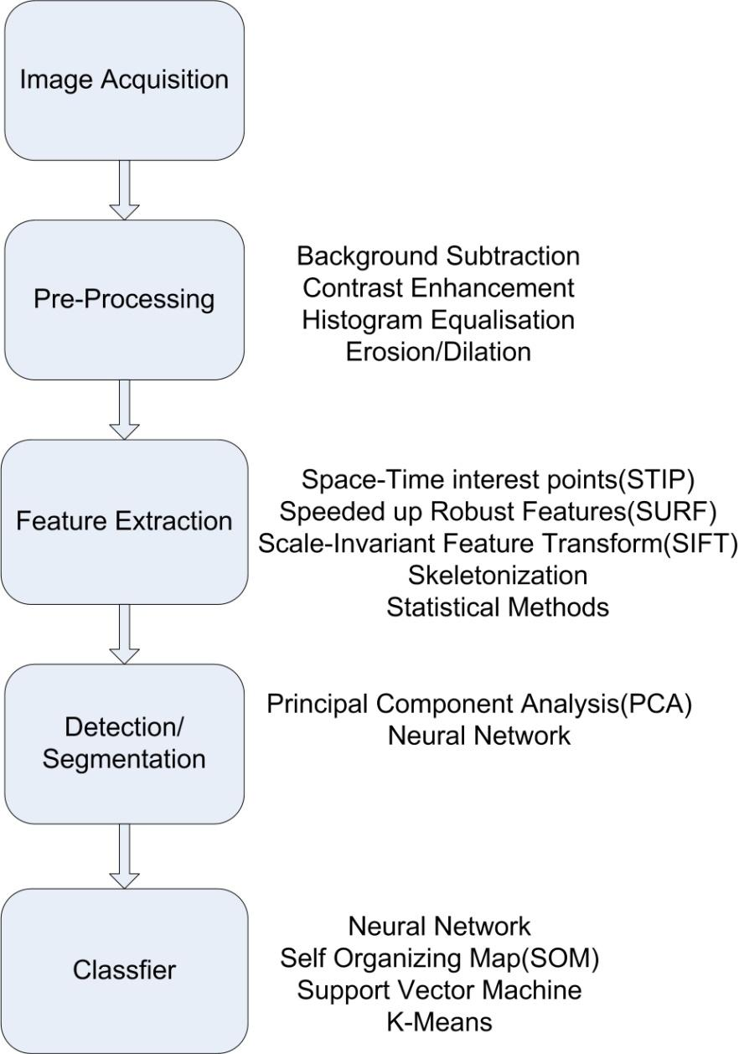
cv2.imread
cv2.bilateralFilter
cv2.cvtColor
cv2.Canny
cv2.findContours

Slide 26
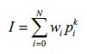
The concept of "image moments" basically refers to the weighted and power-raised summation of the pixels within a shape.

Slide 27
If we match the shapes, you will see something like this:

Slide 28
Approximating a contour
Let's start with a factor of 0.05:

Slide 29
If you reduce this factor, the contours will get smoother. Let's make it 0.01:

Slide 30
If you make it really small, say 0.00001, then it will look like the original image:

Slide 31
Identifying the pizza with the slice taken out
Let's consider the following image:

Slide 32
If you look at the sliced pizza shape, we can choose two points such that the line between them goes outside the shape as shown in the figure that follows:

Slide 33
If you run the above code, you will see something like this:

Slide 34
If you run the preceding code, the output will look like the following:

Slide 35
How to censor a shape?
Let's consider the following figure:

Slide 36
This metric will have a lower value for the boomerang shapes because of the empty area that will be left out, as shown in the following figure:

Slide 37
If you detect the shapes and block them out, it will look like this:

Slide 38
Object Tracking

Slide 39
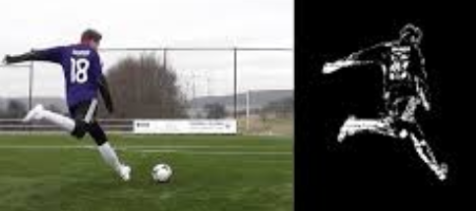
Frame differencing
This is, possibly, the simplest technique we can use to see what parts of the video are moving. When we consider a live video stream, the difference between successive frames gives us a lot of information. The concept is fairly straightforward! We just take the difference between successive frames and display the differences.

Slide 40
If I move my laptop rapidly from left to right, we will see something like this:

Slide 41
Colorspace based tracking
can convert an image to the HSV space, and then use colorspacethresholding to track a given object.

Slide 42
If you run it through the colorspace filter and track the object, you will see something like this:
Consider the following frame in the video:

Slide 43
Introduction to YOLO
YOU ONLY LOOK ONCE - Real-Time Object Detection

Slide 44
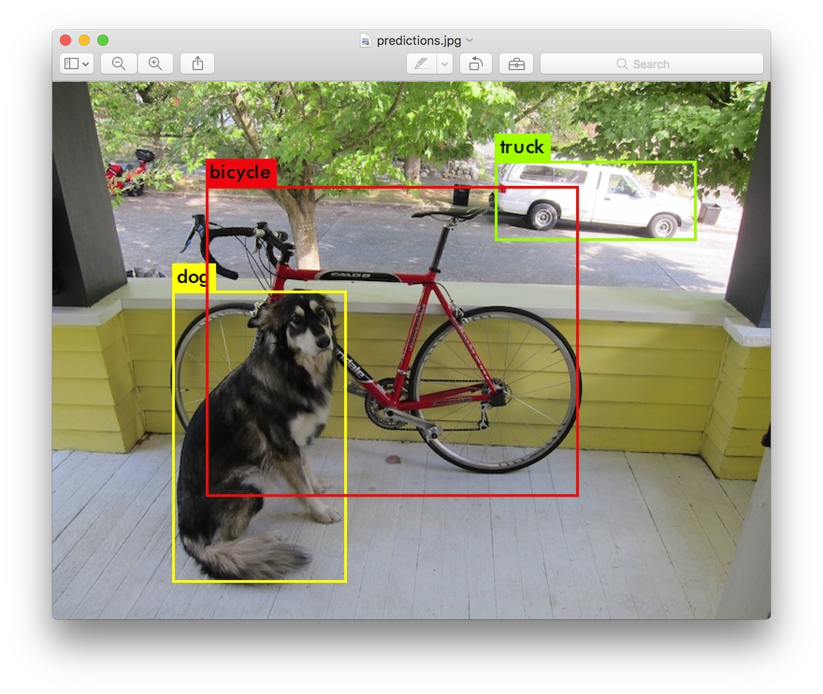

Slide 45
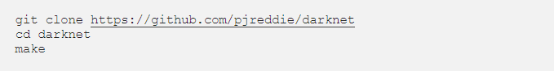
Installation on YOLO
Open Terminal in your working directory, clone the Darknet repository, and build it:
Then, run
and you should have the output:

Slide 46
Testing Model
Tiny YOLOv3
To use this model, first download the weights:
Then run the detector with the tiny config file and weights:

Slide 47
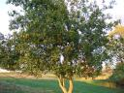
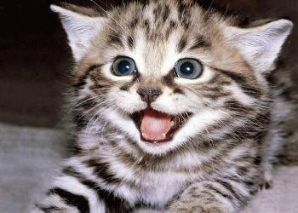
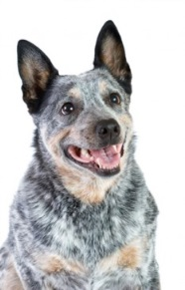
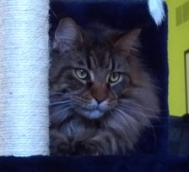
Deep Learning Framework
Forward Propagation
Repeat
“turtle”
Tree
Backward Propagation
Cat
Update the weights to nudge
from “turtle” towards “dog”
Trained Model
Dog
“cat”
Notes:
Here I will illustrate how a deep learning system is trained.
Say that we have a partially trained network, and some training images,
<click> of which we select one.
<click> We pass the image in and analyze it using the network and they weights stored in the connections of the network,
<click> and get a result that is wrong.
<click> As we see that there was an error, we can propagate the errors backward, and modify the weights in the network so that the next time a similar image is shown, the system is more liklely to give a correct answer.
<click – click> And then we repeat this with more training examples.
<click> Eventually, we stop training, freeze the weights,
<click> and can use the system to correctly analyze new images.
47

Slide 48
Artificial neurons
F(x) = Activation Function
AND Gate
y
w₁
w₂
w₃
y=F(w₁x₁+w₂x₂+w₃)
x₁
x₂
1
x1 | x2 | y
0 | 0 | 0
1 | 0 | 0
0 | 1 | 0
1 | 1 | 1
Input: 0 or 1

Slide 49
Artificial neurons
F(x) = Activation Function
AND Gate
y
w₁
w₂
w₃
y=F(w₁x₁+w₂x₂+w₃)
x₁
x₂
1
Epoch 1:
W1=5; W2=5; W3 = -10
Epoch 2:
W1=6; W2=6; W3 = -10
Input: 0 or 1
Epoch 100:
W1=20; W2=20; W3 = -30

Slide 50
Deep Learning generalizes solution across problems
Varied data types
(and multi-source)
Varied tasks
Real-valued feature vector
Classification
Structured
x₁
x₂
x₃
...
x_{N}
Regression
NUMBERS
Unsupervised learning
Clustering
Topic extraction
Anomaly detection
IMAGES
SOUNDS
VIDEOS
TEXT
Unstructured
Sequence prediction
Control policy learning
Constants: Big (high dimensional) Data + a complex function to learn

Slide 51
Install YOLO BBox Annotation Tool
Open the terminal and type
$ git clone https://github.com/drainingsun/boobs.git

Slide 52
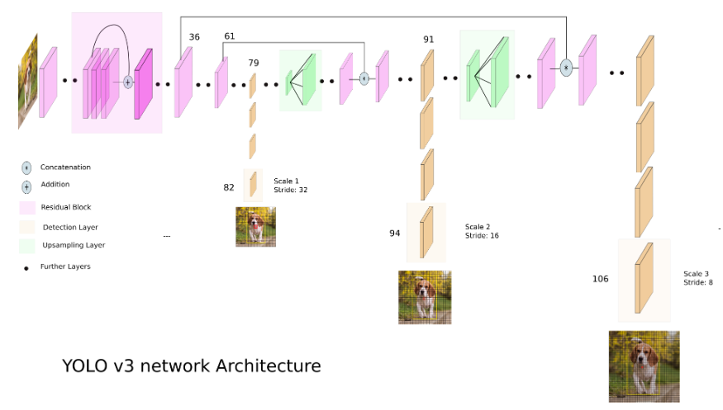
What is YOLOv3?
YOLO applies a single neural network to the full image for both classification and localization.

Slide 53
Creating train.txt and test.txt

Slide 54
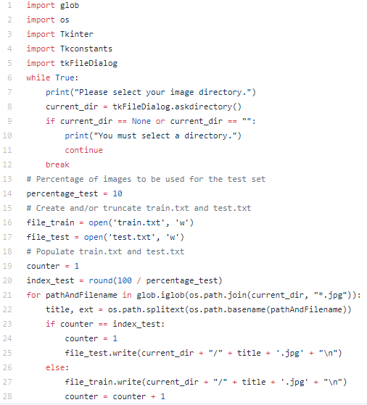
1.) save split.py in your working directory.

Slide 55
2.)open Terminal in the directory of split.py and run:
3.) You should see that two new files have been created in your working directory after selecting the directory of where you’ve saved your images in the pop-up GUI.
4.) move and to the Darknet directory.

Slide 56
Downloading pre-trained weights
5.)Save the weights for the convolutional layers to the Darknet directory:

Slide 57
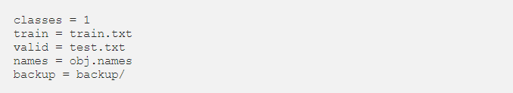
Configuring .data
In your Darknet directory, create and fill in the contents with the following:

Slide 58
Configuring .names
In your Darknet directory, create and fill in the contents with the name of your custom class. For example, the contents of your may simply be:
Object name

Slide 59
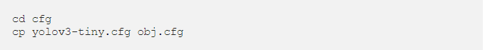
Configuring .cfg
We will now create a file to define our architecture. Let’s get us started.
1.) yolov3-tiny.cfg
Go to the cfg directory under the Darknet directory and make a copy of yolov3-tiny.cfg:
Open obj.cfg with a text editor and edit as following:
In line 3, set batch=24 to use 24 images for every training step.
In line 4, set subdivisions=8 to subdivide the batch by 8 to speed up the training process and encourage generalization.
In line 127, set filters=(classes + 5)*3, e.g. filters=1.
In line 135, set classes=1, the number of custom classes.
In line 171, set filters=(classes + 5)*3, e.g. filters=1.
In line 177, set classes=1, the number of custom classes.
Then, save the file.

Slide 60
Change configurations to save weights at lower iteration intervals
To save your weights at lower iteration intervals,
1.) Open under directory in the Darknet directory with a text editor.
2.) edit line 138 to describe when you would like your weight to be saved.
3.) Finally, save the file and run

Slide 61
Train models
To start training, open Terminal the directory of Darknet and run:

Slide 62
Waiting

Slide 63
End of DAY 2
See you tomorrow

